Slide 1
Recognition of hand written digits
(Zip Code Prediction)
Group 19
Charan Kumar Reddy Sadipirala
Ravi Chandra G0timukula
Vinson Chen

Slide 2
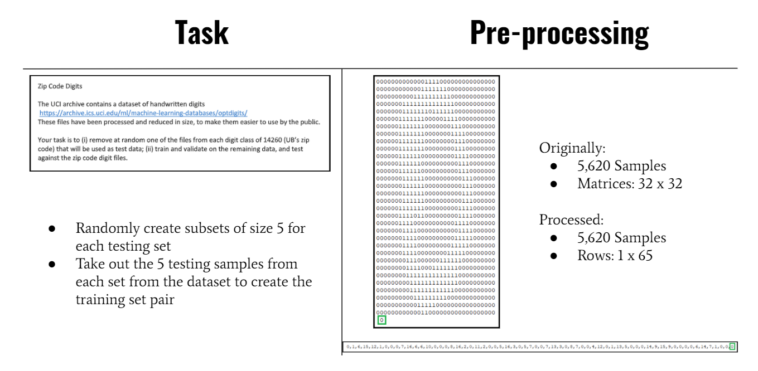

Slide 3
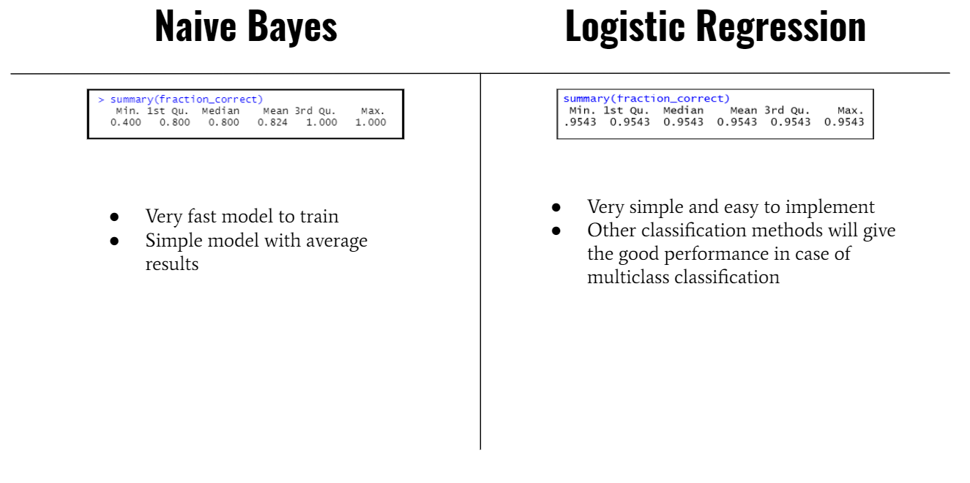

Slide 4
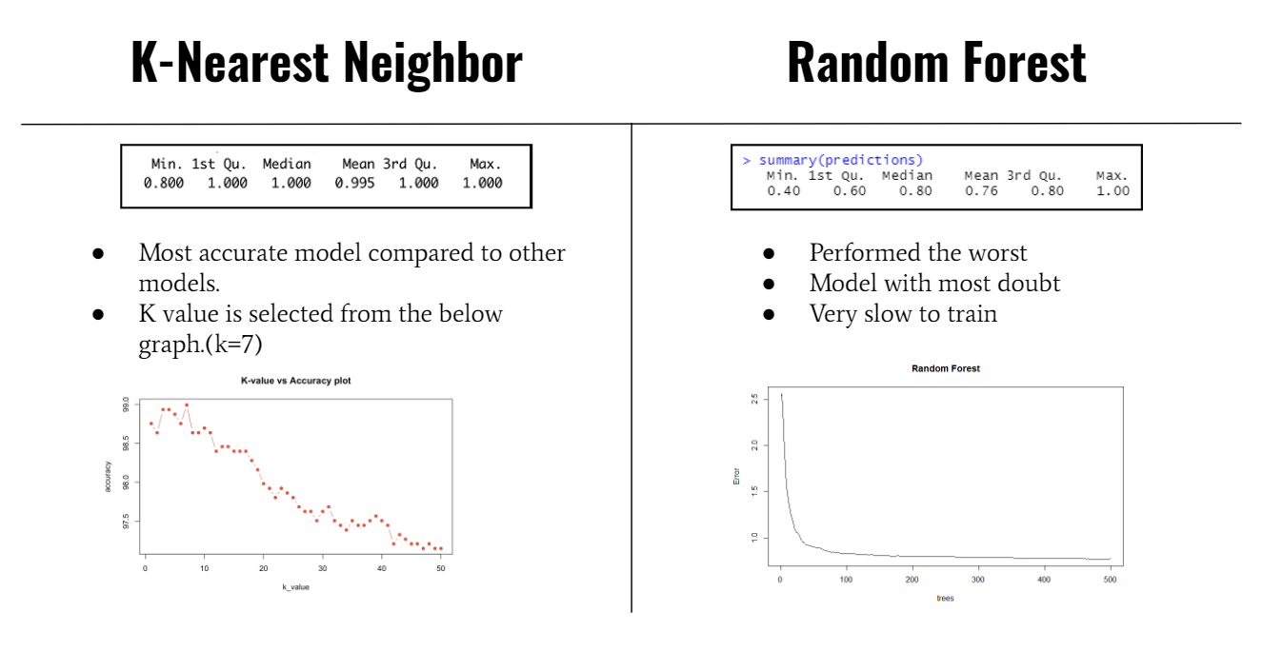

Slide 5
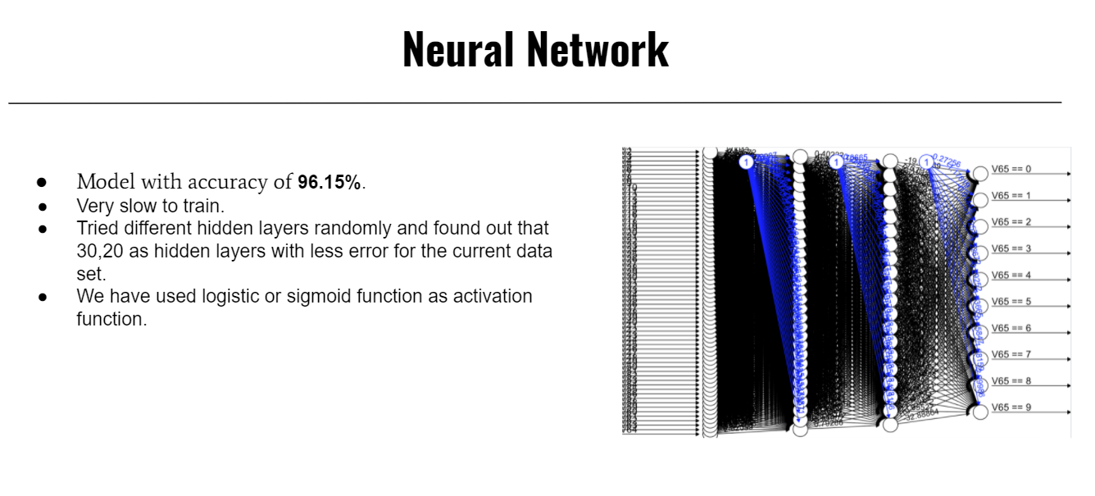

Slide 6
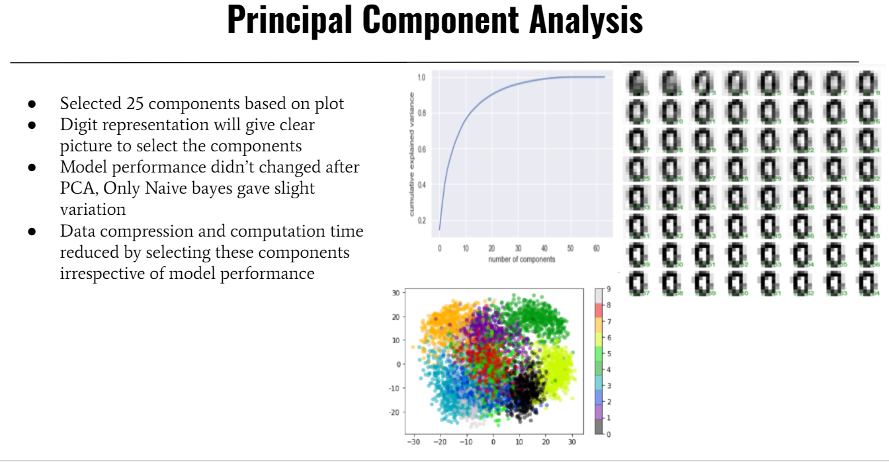

Slide 7
